Slide 1
Distributing Economic Resources

Slide 2
Economic System
The quantity and variety of goods and services that a country can produce depend on the factors of production that are available to that country.
Therefore, each country must take their own factors of production into account when deciding:
Which goods and services can be produced
How much of these goods and services can be produced
Who should be responsible for producing and distributing these goods and services
How the production and distribution of these goods and services should be organised
The way a country decides to use its factors of production to produce and distribute goods and services is referred to as the economic system of that country.

Slide 3
Types of Economic System
Centrally Planned Economy or Command Economy
The government of a country makes all the decisions about the production of goods and services.
Firms that provide goods and services are controlled by the government
The citizens of the country have very little involvement in business
Personal tax rates may be higher due to a higher level of public services
There is a more equal distribution of wealth between the citizens of the country
Benefits
All essential goods and services will be provided for all citizens of the country.
Drawbacks
Consumers are not free to purchase any goods or services they want, as they are limited to what the government has decided should be made available in the economy.
Prices may be higher than they need to be due to the lack of competition.
There is no incentive for businesses to become more efficient.

Slide 4

Types of Economic System
Free Enterprise Economy or Free Market Economy
In a free enterprise (or free market) economy, the citizens of a country are free to set up businesses in any area they like (provided they stay within the law, of course) with very little interference from the government. The US is an example of a free enterprise economy.

Slide 5
Types of Economic System
Free Enterprise Economy or Free Market Economy
Benefits
Consumers have a wide range of goods and services to choose from.
Prices tend to be lower, as firms try to compete.
Taxes tend to be lower, as there is less government spending on public services.
Drawbacks
Less money is spent on public services.
Social welfare payments for the unemployed or people who are ill are very low.
Dangerous or unsafe goods may be on sale due to a lack of regulation.
Small firms may be unable to compete and may go out of business.
The wealth of a country is not evenly distributed between the citizens, resulting in a big gap between rich and poor.

Slide 6
Types of Economic System
Mixed Economy
A mixed economy is a combination of a centrally planned and free enterprise economy.
In a mixed economy, the production of goods and services is shared between government and business. This means that:
In most areas citizens are free to set up businesses to produce goods and services provided they stay within the law.
In some areas the government will control an area of business, either by issuing licences, for example a licence to operate a radio station or mobile phone network, or by operating an element of the business themselves, for example public transport.
Ireland is an example of a mixed economy.

Slide 7
Types of Economic System
Mixed Economy
Benefits
Consumers have a wide choice of goods and services.
Essential services are made available to all sections of the population.
In some areas of activity, consumers have a choice between a public and a private operator.
Public amenities such as parks, street lighting, roads, and bicycle and bus lanes are provided by the government for the benefit of all.
Laws exist to protect consumers from dangerous and sub-standard goods and services.
Drawbacks
The limited income available for spending on public services can result in long waits for medical procedures, higher prices and reduced levels of customer service.
Government regulation reduces competition.

Slide 8
Sectors of the Economy
Public Sector
The public sector is the part of the economy where the government provides services to the citizens of the country, for example civil servants, teachers, Gardaí, county council workers, employees of state firms and the doctors and nurses who work in our hospitals.
The public sector operates through government departments or state-owned companies and institutions.
Services provided by the state for the people of the country are known as public utilities.

Slide 9
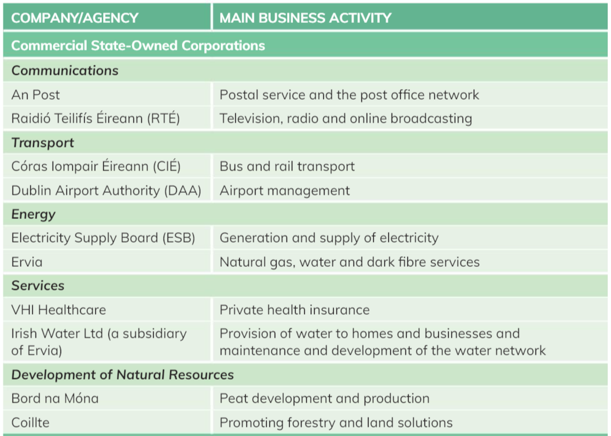

Slide 10
Sectors of the Economy
Local Authorities
Every year, the government allocates money in the national budget to the city and county councils around the country. These councils are known as local authorities and are responsible for providing important services in their local areas.
Each city and county council will also prepare a budget that shows how they intend to spend the money that has been given to them. Local authorities also generate some funding themselves from the Local Property Tax, rates (rent), fines, planning application fees and other charges.
Some of the services provided by local authorities include the following:
Council houses and flats
Public parks and green areas
Services and housing for Traveller families in their area
Public libraries, museums and theatres
Street lighting and other essential services
Planning permission service

Slide 11
Private Sector
People who are not employed by the state are said to work in the private sector, for example engineers, carpenters, plumbers, accountants, solicitors, bank workers, construction workers, etc.
Therefore, when we are talking about economic systems, the private sector refers to businesses that are owned and operated by private individuals.

Slide 12

Sectors of the Economy
Voluntary Sector (Third Sector)
The voluntary or not-for-profit sector comprises all the charities, social enterprises and cultural enterprises in the country.
They are independent of the government but may receive funding in the form of a grant or subsidy to help them with their work.
The main characteristics are that they aim to achieve some social objective and always reinvest any profits they make in furthering their aims.

Slide 13
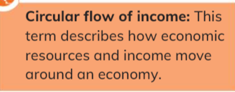
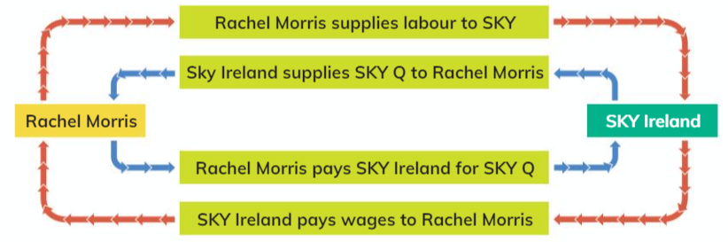

Slide 14
